Slide 1
RA 505 Robot Sensing and Vision Lecture 27
Dr. Rishikesh Kulkarni
Department of Electronics and Electrical Engineering
IIT Guwahati

Slide 2
Photodetector in a pixel
Microlens array
On-chip microlens array(OMA)
Collimates light to the photodiode
color filter layer-> transparent resin
photolithographic patterning
Increase in sensitivity
Shading effect
Reduce smear in CCD image sensors and crosstalk between pixels caused by minority carrier diffusion
Reflection at SiO2 and Si interface
Refractive index variation causes reflection
more than 20 to 30% of the incident light is reflected at the silicon surface in the visible light range
Anti-reflective films formed above the photodiode

Slide 4
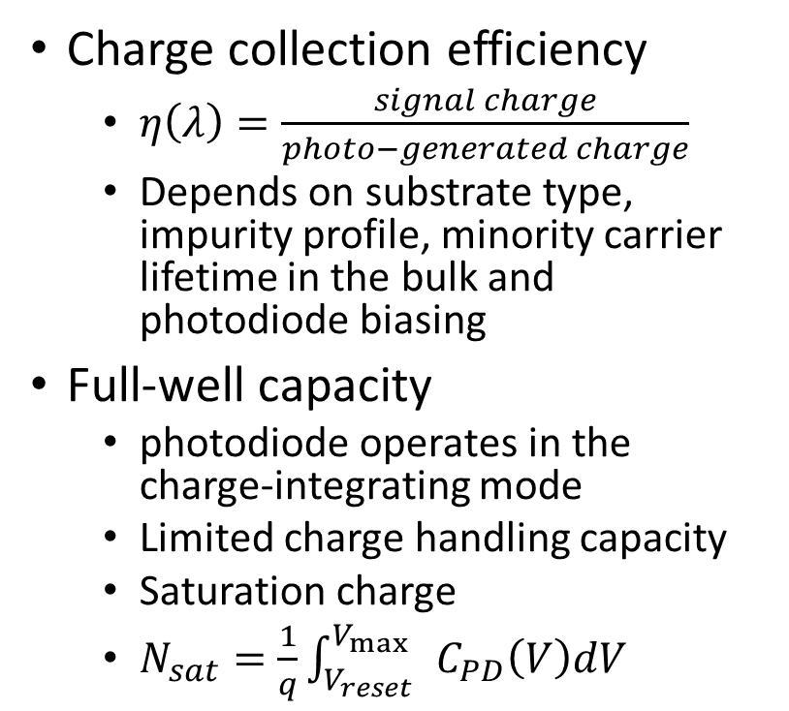
Photodetector in a pixel
Charge collection efficiency
$η\left(λ\right)=\frac{signal charge}{photo−generated charge}$
Depends on substrate type, impurity profile, minority carrier lifetime in the bulk and photodiode biasing
Full-well capacity
photodiode operates in the charge-integrating mode
Limited charge handling capacity
Saturation charge
$N_{sat}=\frac{1}{q}\int_{V_{reset}}^{V_{\max{ }} }{C_{PD}\left(V\right)dV}$

Slide 5
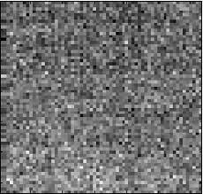

Noise
Fixed pattern Noise (FPN) vs Random/Temporal noise
FPN at dark: dark signal non-uniformity (DSNU)
FPN at illumination: photo-response nonuniformity (PRNU)
Exposure variation: sensitivity nonuniformity or gain variation
FPN sources: long exposure times /high temperatures (CCD), dark current nonuniformity and performance variations of an active transistor inside a pixel (CMOS)
Dark current
reduces the imager’s useable dynamic range
Generation Current in the Depletion Region
Surface Generation
Diffusion current
Temperature Dependence

Slide 6
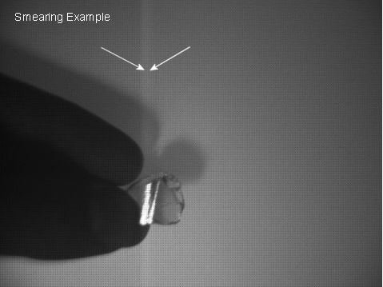
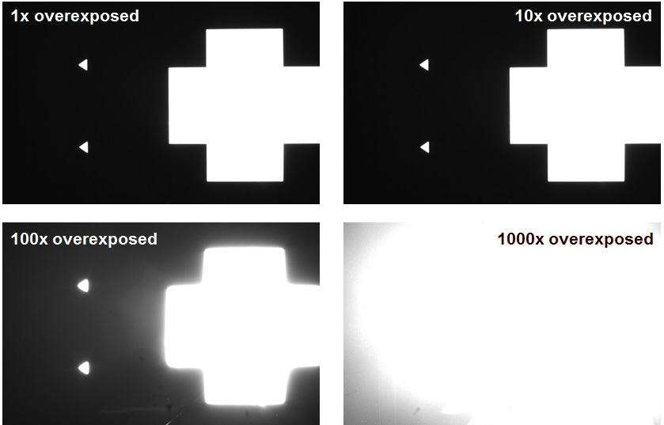
Noise
Shading
slowly varying or low spatial frequency output variation
Dark-current-oriented, Microlens-oriented, Electrical-oriented shading
Temporal noise
random variation in the signal over time
Probability distribution
Thermal noise
thermal agitation of electrons
Shot noise
arises because of the discrete nature of the charges carried by charge carriers
Power spectral densities of thermal noise and shot noise are constant over all frequencies.
1/f noise: correlated double sampling
Read noise/noise floor
Smear: white vertical stripes
Blooming: photogenerated charge exceeds a pixel’s full-well capacity
Image lag

Slide 8
Photoconversion characteristics
Quantum efficiency
Responsivity
Dynamic range:
Signal to noise ratio

Slide 9
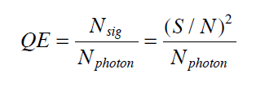
Photoconversion characteristics
Estimation of quantum efficiency

